Slide 1
K.S SCHOOL OF BUSINESS INFORMATION AND INFORMATION TECHNOLOGY TRADEMARK ISSUES IN CYBER SPACE Faculty : Moinuddin Quraishu
3241 Shah Jolly
3246 Thakkar Akshi
3248 Thakkar Krupa

Slide 2

WHAT IS TRADEMARK?
A trademark is a recognizable insignia, phrase, word, or symbol that denotes a specific product and legally differentiates it from all other products of its kind. A trademark exclusively identifies a product as belonging to a specific company and recognizes the company's ownership of the brand.

Slide 3
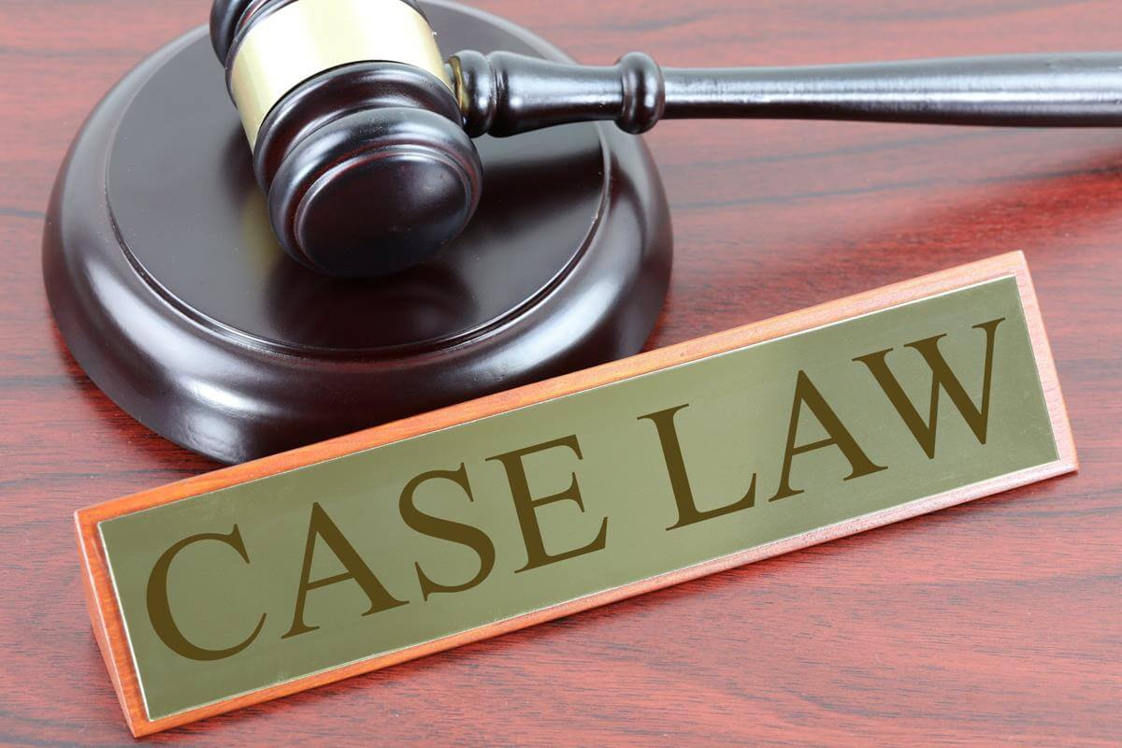
TRADEMARK ISSUE IN CYBER SPACE
The development of internet and the exchange of data amongst different computers led to major technological as well as telecommunication revolutions.
2016 report of PWC emphasized that at a global level cyber crime is the second most reported crime in the world.
There are mainly 5 trademark issues in cyber space:
1. domain name
2.linking & framing
3.meta tagging
4.jurisdiction issues
5.dilution

Slide 4

ORIGIN OF DOMAIN NAME
Domain name are created out of naming space and methodology that was first defined by Paul Mockapetris in IETF publication RFC 882 and RFC 883 (1983) and used in first expansion of the ARPANET. a predecessor of today’s Internet.

Slide 5
DOMAIN NAMES
We have address for our home and offices. The same way domain names are simple from of addresses on the internet. This address unable users to locate Website on the net in an easy manner.
Domain names correspond to various IP (Internet protocol) numbers which connect various computers and enable direct network routing system to direct data request to the correct addressee.
In other words, a domain name is a “uniform resource locator “. Besides locating sites, domain names also have a function to identify businesses and there and their goods and services on the net, which gives them an edge over their competitors.

Slide 6
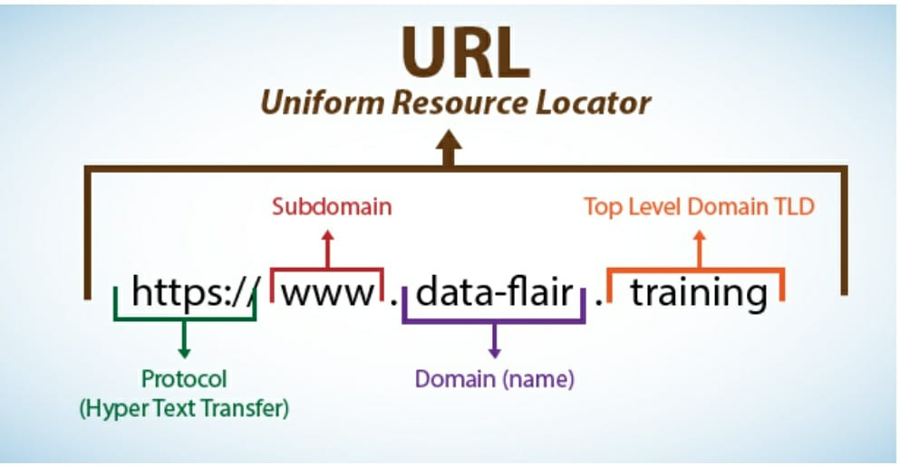
EXAMPLE OF DOMAIN NAME
.com .edu .org . gov top level domain name
.in .uk Country code top-level domain
.london .asia Geodomain name (graphical entites)

Slide 7
MARKET VALUE OF DOMAIN NAME
Various factors influence the perceived value or market value of a domain name. They include:
The natural or “organic” traffic that can be attributed to web suffers typing in a domain name in their web browser as opposed to doing a search for the site through a search engine.
Branding opportunity. The ability to have a term recognized and easily recalled as brand for a company or entity.
Re-sale value. the ability to spot trends and predict the value of name based on its length, clarity, and commercial use.

Slide 8
DOMAIN NAME DISPUTE IN INDIA
A domain name disputes a legal complaint made on the grounds that a domain name has been inappropriately and illegitimately used for assigned.
It is general practice where companies desire to obtain such domain names which can be easily identified with their establish trademarks.
The helps the public to identify the company as the re is no physical contact between the two of them.

Slide 9

CYBERSQUATING
“An act of obtaining fraudulent registration with an intent to sell the domain name to the lawful owner of name at a premium.”

Slide 10
UNDER WIPO, CYBERSUATTING IS
The domain is identified or misleadingly similar to trade or service mark in which the complainant has a right
The holder of the domain name has no right or legitimate interest in respect of the domain name; and
The domain name has been registered and is used in bad faith.

Slide 11
EXPLANATION
Cybersquatting is a huge problem in internet today. It Is the most crucial type of domain dispute prevalent around the word.
It is a practice where individual by domain names reflecting the name of existing companies, with an intention to sell the names back to attain profit when they want to set up their own websites.
Many multinational companies like Tata, Bennett & Coleman, Mc Donald’s etc. Were among the first victim of cybersquatting.

Slide 12

EXPLANATION
The domain name system is that it serves as the “phone book” for the Internet by translating human-friendly computer hostnames into IP address. For Example, www.cyberlawconsulting.com translate to 208.77.188.166
Domain name are used in a variety of context for identification, reference, and access to internet resources. They can appear as component of ‘Web sites’

Slide 13
PASSING OF CYBERSUATTING
Passing off action is where the defendant is restrained from using the name of the complaint to pass off the goods or services to the public as that of the complainant.
It is an action to preserve the goodwill of the complaint and also to safeguard the public.
In India cybersquatting cases are decided through the principle of passing off.
India does not have a law for prohibition of cybersquatting. Therefore, courts interpret the principle of passing off regard to domain names.

Slide 14
ICANN
ICANN stands for Internet corporation for Assigned Names and Numbers.
The right to use a domain name is delegated by domain name registrars.
Formed in 1998.
Each level domain is maintained and serviced technically by sponsoring organization, the Registry.
NATIONAL INTERNET EXCHANGE OF INDIA
TLD Database(Top-level domain)
The rules of assignment specify that no legal ownership is conferred with such transaction, only the right of exclusive use and the authority to the name space.

Slide 15

WHAT DOES ICANN DO ?
To reach another person on the Internet you have to type an address into your device – a name or a number . That address must be unique , so computers will know where to find each other . ICANN maintains and administers these unique identifiers across the world .Without ICANN's management of this system ,known as the Domain Name System ( DNS ) , we wouldn't have a global , scalable Internet where we can find each other .

Slide 16
ICANN’S ROLE
ICANN is responsible for coordination of the global internet’s unique identifiers; to ensure secure and stable operation of these systems
ICANN staff does not create policy; we support and resource the worldwide community, who determine Internet policy in “bottom up” manner
ICANN mandate is to make competition and choice available in a safe, secure operating environment. Examples are new gTLDs and IDN’s

Slide 17
CASE LAW
The first case in India with regard to cybersquatting was Yahoo Inc. vs Akash Arora, where the defendant launched a website nearly identical to the plaintiff’s renowned website and also provided similar services. Here the court ruled in favour of trademark rights of U.S based Yahoo.Inc and against the defendant, that had registered itself as YahooIndia.com. The court observed, ”It was an effort to trade on the fame of yahoo’s trademark. A domain name registrant does not obtain any legal right to use that particular domain name simply because he has registered the domain name, he could still be liable for trademark infringement”.

Slide 18
CONCLUSION
The development of the internet services has changed the face of the world and has affected all aspects of the society. The Domain names have become an important element in the cyberspace and the crimes regarding the same are on the rise in context to trademarks.
Cybersquatting has opened the eyes of governments across the world and has prompted them to look into this phenomenon in a serious manner. The united states by enacting the ACPA, has taken a monumental step in protecting domain names in its cyberspace. It is high time Indi and other countries come out with legislations to protect this virus from spreading.

Slide 19
THANK YOU

